Slide 1
Introduction to DocFX
The evolution
And lessons learnt

Slide 2
Agenda
Basic Introduction
DocFX Walkthrough (DEMOs)
Inside DocFX
Evolutionary History
Lessons learnt

Slide 3

Basic Introduction
Why call it DocFX
Inspired by CoreFX, stands for Document Framework
Codename: docfx
Open source
https://github.com/dotnet/docfx
701 Stars

Slide 4
Open Source Involvements
701 Stars
40+ external contributors
Around 10 active contributors, issues, PRs, gitter.com
@jonskeet, @bitbonk, @dlech, @AustinWise, @pascalberger, @richardschneider, @ferventcoder, @agc93, …
Collect feedbacks from
Feethub.com: a feature upvoting system
Disqus.com: commenting system

Slide 5
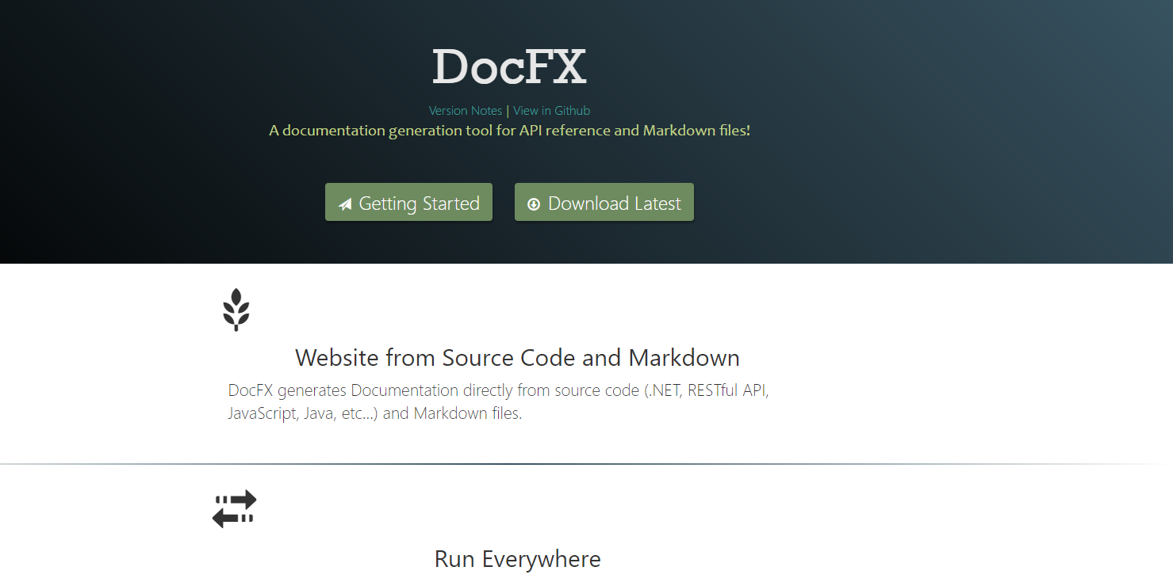

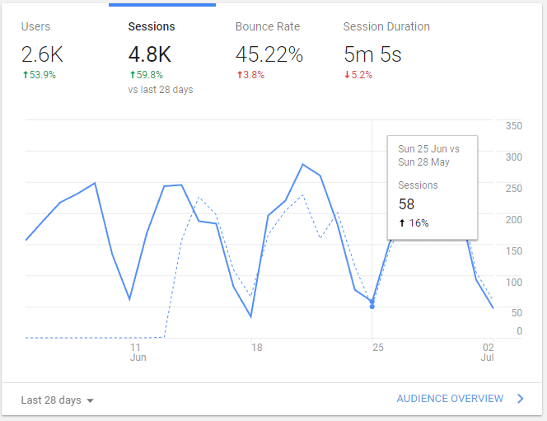
Homepage http://dotnet.github.io/docfx/
Generated by DocFX,
Google Analysis

Slide 6
